Slide 1
PHYS 221 Recitation Quiz
Kevin Ralphs
Geometric Optics

Slide 2
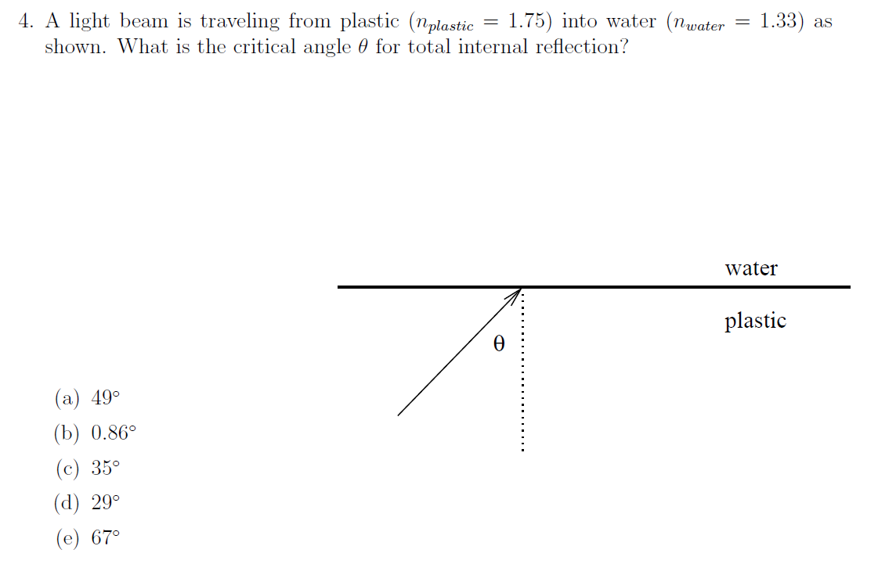
Quiz Question
Notes:
Answer: a

Slide 3
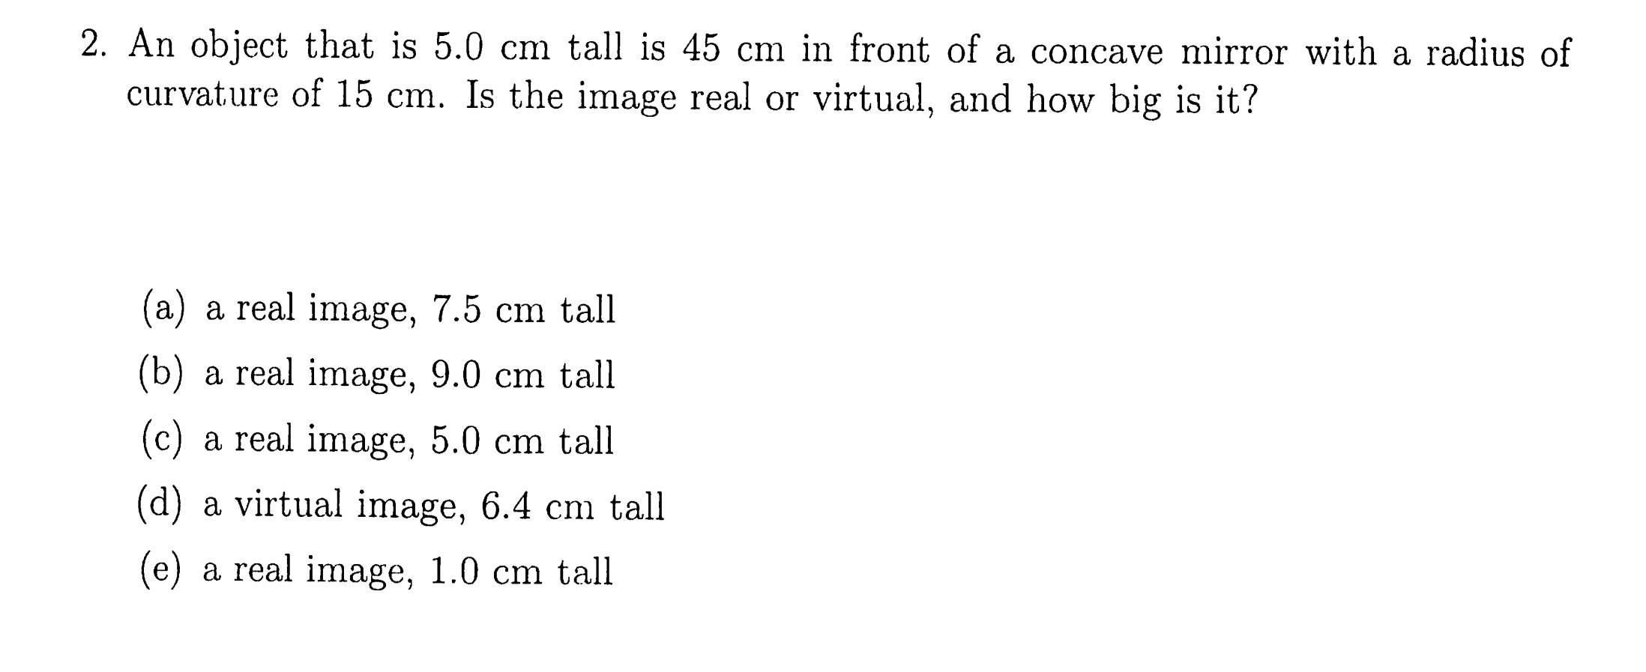
Quiz Question
Notes:
Answer: e

Slide 4
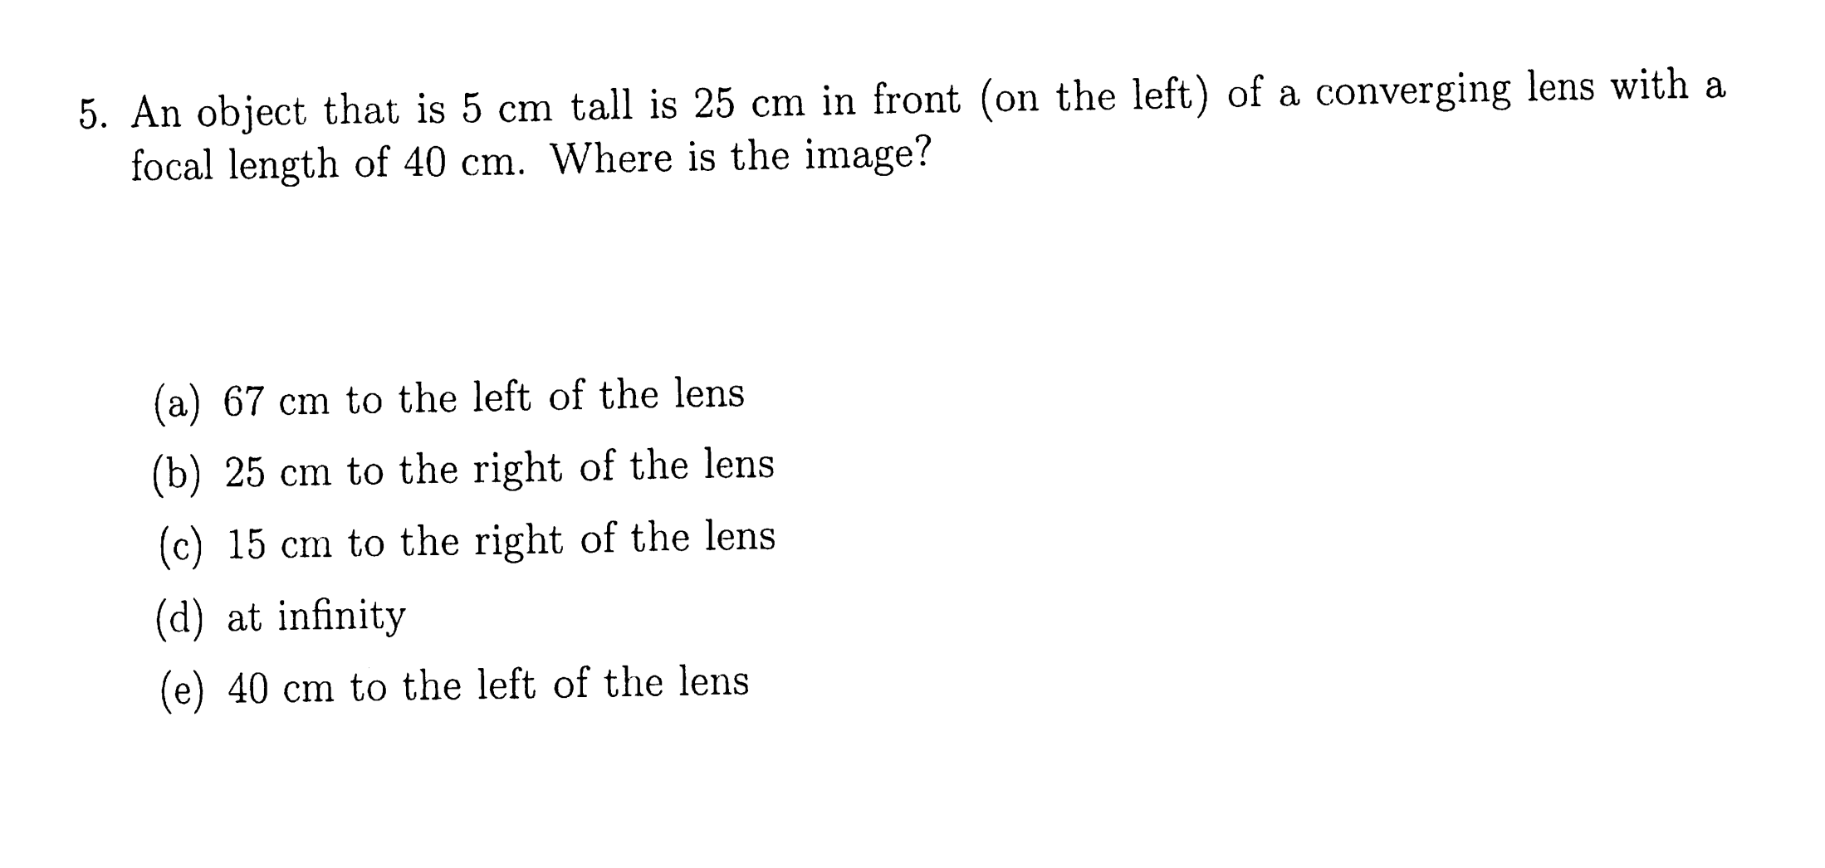
Quiz Question
Notes:
Answer: a

